Slide 1
K-MEANS Algorithm
DATA MINING
CLUSTERING METHOD

Slide 2
Introduction
Clustering is a data mining technique to partitioning data into groups (clusters or segments) where each cluster have some members.
Clustering is a grouping method based on the similarity distance.
Clustering do not requires previous knowledge (unsupervised learning).

Slide 3
Introduction
K-Means was first addressed by J.B. Macqueen in 1976, as the most common clustering method to partitioning data based on the similarity approach.
The group of the data as known as cluster.
Data in a cluster have similar characteristic (or feature, attribute, property).
Clustering K-Means can only be used for numerical data type.

Slide 4
The Use of K-Means
Object identification (Recognition):
For image processing, computer vision or robot vision.
Decision Support System and data mining:
Market segmentation, area mapping, marketing management etc.

Slide 5
Applications Examples
Biology: taxonomy of living things: kingdom, phylum, class, order, family, genus and species
Information retrieval: document clustering
Land use: Identification of areas of similar land use in an earth observation database
Marketing: Help marketers discover distinct groups in their customer bases, and then use this knowledge to develop targeted marketing programs
City-planning: Identifying groups of houses according to their house type, value, and geographical location
Earth-quake studies: Observed earth quake epicenters should be clustered along continent faults
Climate: understanding earth climate, find patterns of atmospheric and ocean
Economic Science: market research
Etc.

Slide 6
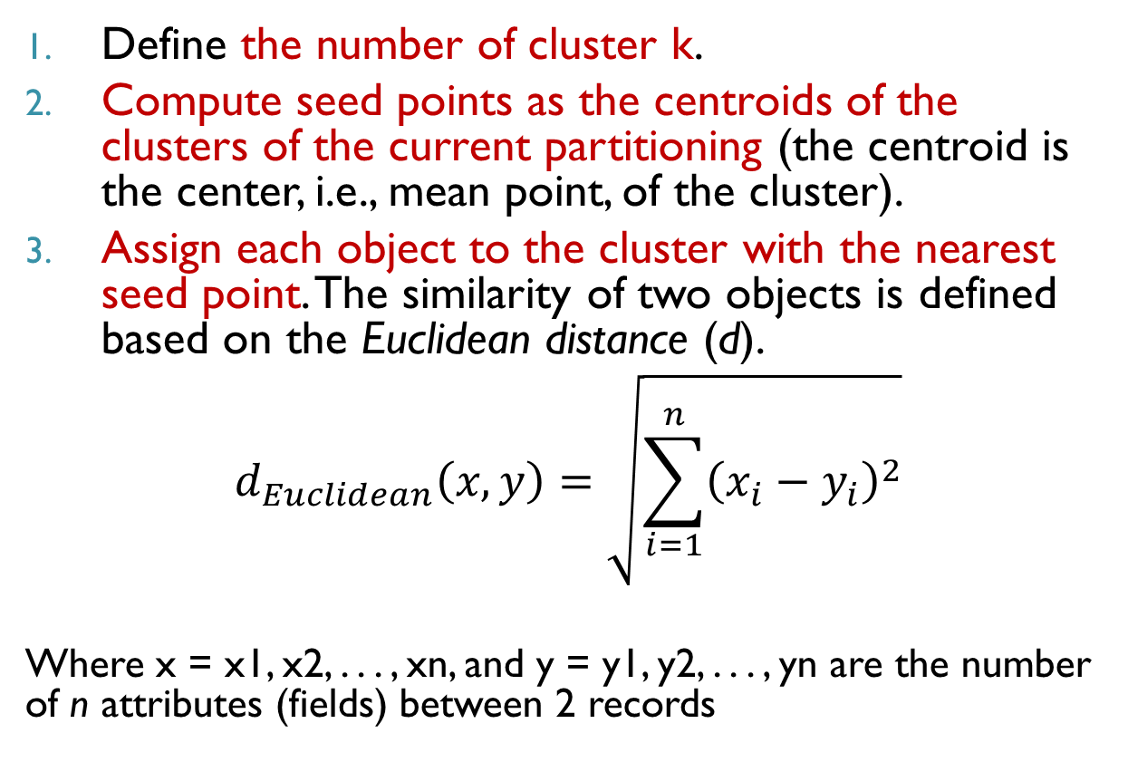
Procedure of Clustering: K-Means
Define the number of cluster k.
Compute seed points as the centroids of the clusters of the current partitioning (the centroid is the center, i.e., mean point, of the cluster).
Assign each object to the cluster with the nearest seed point. The similarity of two objects is defined based on the Euclidean distance (d).
$$d_{Euclidean}\left(x,y\right)=\sqrt{\sum_{i=1}^{n}{{\left(x_{i}−y_{i}\right)}^{2}}}$$
Where x = x1, x2, . . . , xn, and y = y1, y2, . . . , yn are the number of n attributes (fields) between 2 records

Slide 7
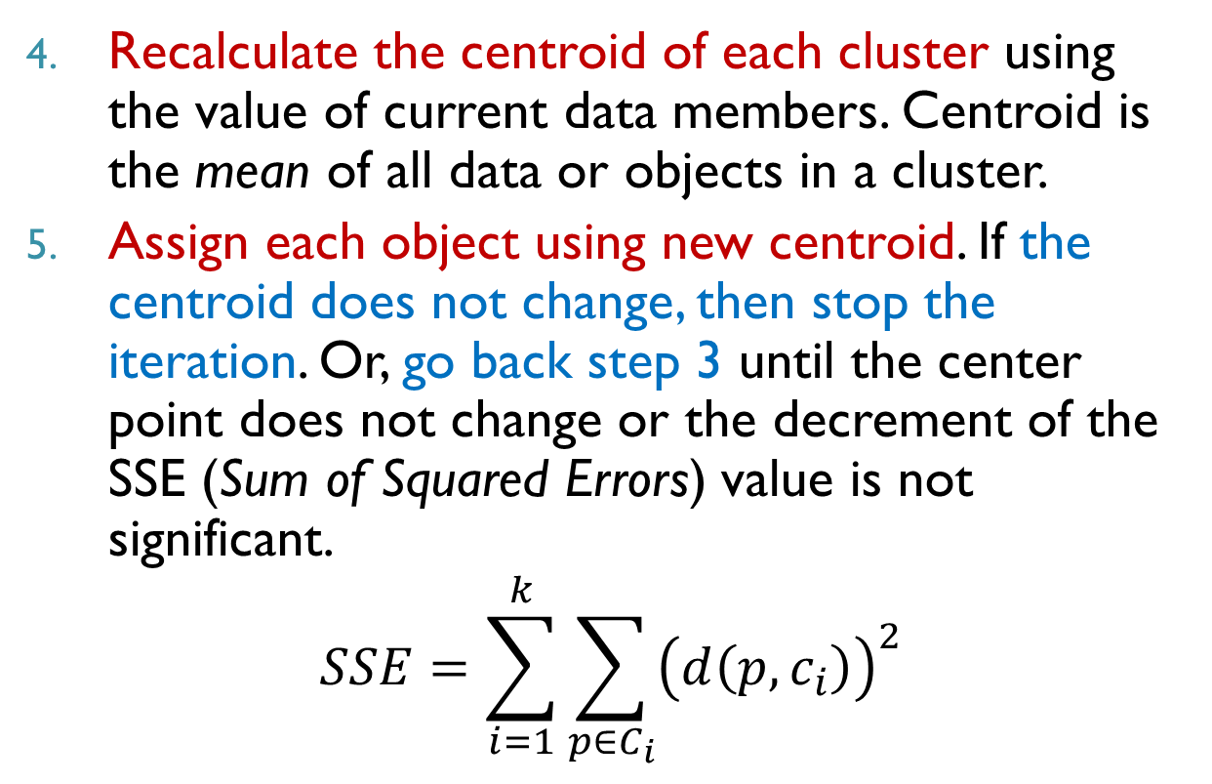
Procedure of Clustering: K-Means
Recalculate the centroid of each cluster using the value of current data members. Centroid is the mean of all data or objects in a cluster.
Assign each object using new centroid. If the centroid does not change, then stop the iteration. Or, go back step 3 until the center point does not change or the decrement of the SSE (Sum of Squared Errors) value is not significant.
$$SSE=\sum_{i=1}^{k}{\sum_{p∈C_{i}}{{\left(d\left(p,c_{i}\right)\right)}^{2}}}$$

Slide 8
Example of dataset: K-Means (given 1 attribute)
Make 2 clusters based on the following data:
Data | Value X
A | 2
B | 3
C | 4
D | 10
E | 11
F | 12
G | 20
H | 25
I | 35

Slide 9
Step of Iteration 1
Given k = 2
Define the initial centroid (randomly from the dataset) for each cluster. e.g.
centroid C1 (m1) = 20,
centroid C2 (m2) = 25
Calculate the distance of each X with the centroid of each cluster using Euclidean Distance
Find the SSE.

Slide 10
Iteration1
Initial Centroid | X
m1 | 20
m2 | 25
Data | Distance m1 | Distance m2 | Cluster
A | 18 | 23 | C1
B | 17 | 22 | C1
C | 16 | 21 | C1
D | 10 | 15 | C1
E | 9 | 14 | C1
F | 8 | 13 | C1
G | 0 | 5 | C1
H | 5 | 0 | C2
I | 15 | 10 | C2
SSE | 1214
SSE = 18²+17²+16²+10²+9²+8²+0²+0²+10² = 1214
C1 = {A,B,C,D,E,F,G}
C2 = {H,I}

Slide 11
Step of Iteration 2
Find the new centroid based on the average of data value in each cluster.
centroid C1 (m1) = average(A,B,C,D,E,F,G),
centroid C2 (m2) = average(H,I)
Calculate the distance of each X with the new centroid of each cluster using Euclidean Distance
Find the SSE.

Slide 12
Iteration 2
New Centroid | X
m1 | 8.86
m2 | 30
Data | Distance m1 | Distance m2 | Cluster
A | 6.86 | 28 | C1
B | 5.86 | 27 | C1
C | 4.86 | 26 | C1
D | 1.14 | 20 | C1
E | 2.14 | 19 | C1
F | 3.14 | 18 | C1
G | 11.14 | 10 | C2
H | 16.14 | 5 | C2
I | 26.14 | 5 | C2
SSE | 270.69
SSE = 6.86²+5.86²+4.86²+1.14²+2.14²+3.14²+10²+5²+5² = 270.69
C1 = {A,B,C,D,E,F}
C2 = {G,H,I}

Slide 13
Step of Iteration 3
Due to the member of the clusters has changed, continue to iteration 3.
Find the new centroid based on the average of data value in each cluster.
centroid C1 (m1) = average(A,B,C,D,E,F),
centroid C2 (m2) = average(G,H,I)
Calculate the distance of each X with the new centroid of each cluster using Euclidean Distance
Find the SSE.

Slide 14
Iteration 3
New Centroid | X
m1 | 7.00
m2 | 26.67
Data | Distance m1 | Distance m2 | Cluster
A | 5.00 | 24.67 | C1
B | 4.00 | 23.67 | C1
C | 3.00 | 22.67 | C1
D | 3.00 | 16.67 | C1
E | 4.00 | 15.67 | C1
F | 5.00 | 14.67 | C1
G | 13.00 | 6.67 | C2
H | 18.00 | 1.67 | C2
I | 28.00 | 8.33 | C2
SSE | 216.67
C1 = {A,B,C,D,E,F}
C2 = {G,H,I}
The member of the clusters has not changed since the last iteration, so stop the assignment with the SSE = 216.67

Slide 15
Procedure of K-Means with multiple attribute
Make 2 clusters based on the following data:
DATA | X1 | X2
A | 1 | 3
B | 3 | 3
C | 4 | 3
D | 5 | 3
E | 1 | 2
F | 4 | 2
G | 1 | 1
H | 2 | 1

Slide 16
Step of Iteration 1
Given k = 2
Define the initial centroid (randomly from dataset) for each cluster. E.g.:
centroid C1 (m1) = (1,1),
centroid C2 (m2) = (2,1)
Calculate the distance of each X with the centroid of each cluster using Euclidean Distance
Find the SSE.

Slide 17
Iteration 1
Initial Centroid | X1 | X2
m1 | 1 | 1
m2 | 2 | 1
Data | Distance m1 | Distance m2 | Cluster
A | 2.00 | 2.24 | C1
B | 2.83 | 2.24 | C2
C | 3.61 | 2.83 | C2
D | 4.47 | 3.61 | C2
E | 1.00 | 1.41 | C1
F | 3.16 | 2.24 | C2
G | 0.00 | 1.00 | C1
H | 1.00 | 0.00 | C2
SSE | 36.00
SSE = 2²+2.24²+2.83²+3.61²+1²+2.24²+0²+0² = 36
C1 = {A,E,G}
C2 = {B,C,D,F,H}

Slide 18
Step of Iteration 2
Find the new centroid based on the average of data value in each cluster.
centroid C1 (m1) = average(A,E,G),
centroid C2 (m2) = average(B,C,D,F,H)
Calculate the distance of each X with the new centroid of each cluster using Euclidean Distance
Find the SSE.

Slide 19
Iteration 2
New Centroid | X1 | X2
m1 | 1 | 2
m2 | 3.6 | 2.4
Data | Distance m1 | Distance m2 | Cluster
A | 1.00 | 2.67 | C1
B | 2.24 | 0.85 | C2
C | 3.16 | 0.72 | C2
D | 4.12 | 1.52 | C2
E | 0.00 | 2.63 | C1
F | 3.00 | 0.57 | C2
G | 1.00 | 2.95 | C1
H | 1.41 | 2.13 | C1
SSE | 7.88
SSE = 1²+0.85²+0.72²+1.52²+0²+0.57²+1²+1.41² = 7.88
C1 = {A,E,G,H}
C2 = {B,C,D,F}

Slide 20
Step of Iteration 3
Due to the member of the clusters has changed, continue to iteration 3.
Find the new centroid based on the average of data value in each cluster.
centroid C1 (m1) = average(A,E,G,H),
centroid C2 (m2) = average(B,C,D,F)
Calculate the distance of each X with the new centroid of each cluster using Euclidean Distance
Find the SSE.

Slide 21
Iteration 3
New Centroid | X1 | X2
m1 | 1.25 | 1.75
m2 | 4 | 2.75
Data | Distance m1 | Distance m2 | Cluster
A | 1.27 | 3.01 | C1
B | 2.15 | 1.03 | C2
C | 3.02 | 0.25 | C2
D | 3.95 | 1.03 | C2
E | 0.35 | 3.09 | C1
F | 2.76 | 0.75 | C2
G | 0.79 | 3.47 | C1
H | 1.06 | 2.66 | C1
SSE | 6.25
SSE = 1.27²+1.03²+0.25²+1.03²+0.35²+0.75²+0.79²+1.06² = 6.25
C1 = {A,E,G,H}
C2 = {B,C,D,F}
The member of the clusters has not changed since the last iteration, so stop the assignment with the SSE = 6.25

Slide 22

It’s easy, right?

Slide 23
Exercise
Divide into 2 clusters using the following dataset:
NAME | POINT 1 | POINT 2
JOKO | 8.54 | 8.4
AGUS | 9.98 | 6.81
SUSI | 6.2 | 9.15
DYAH | 5.24 | 7.26
WATI | 5.7 | 5.71
IKA | 8.57 | 5.87
EKO | 7.7 | 7.71
YANTO | 6.6 | 5.7
WAWAN | 9 | 8.12
MAHMUD | 9.81 | 9.58

